Slide 1
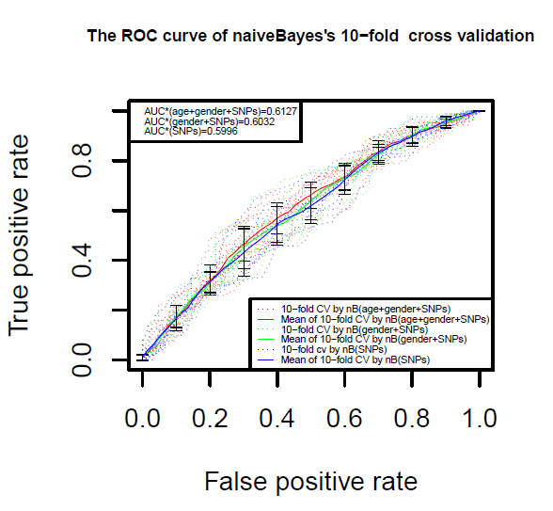
Five significantly thyroid cancer-associated genetic variants which have been discovered and validated by GWAS and case-control studies were taken as the predictor in 9 machine learning/prediction algorithms. We found that the four SNPs were significantly associated with thyroid cancer in Han Chinese population, but with limited power to predict thyroid cancer.

